Slide 1

Rental Property Investment With Time Series Model
Collin Loo

Slide 2


Objective
Business Case | Solution
Identify top 5 zip codes for rental property investment | Develop a time series model to forecast future home values Compute ROI and Risk Select Zip Codes
`

Slide 3

Investment Strategies
Metrics | Criteria
Zip Code Evaluation Metrics Return on Investment (ROI) Price-to-Rent Ratio (PTR) Cash-on-Cash (COC) Rental Index Standard Deviation (RISD) Appendix: Metrics Calculation | ROI > 10% PTR between 11 & 25 COC > 8% RISD between 30th and 60th quantiles

Slide 4
Data Source
Obtain | Preprocess | Merge
Zillow median home sale price Median sale price in 14,723 zip codes Date range 1996 to 2018 Zillow rental index Average rent in 106 metro areas Date range 2014 to 2020 | Calculate historical metrics with Home sale price Rental index | Combine the two data sets based on metro information

Slide 5
Streamline Data
Filter | Subset | Select
Retain zip codes that meet the following ROI > 10% PTR between 11- 25 COC > 8% RISD between 30th and 60th quantile | Select top 3 zip code with the highest ROI from each state | Zip codes with highest ROI and minimum risk 28227 Mint Hill, NC 29472, Ridgeville, SC 28273, Charlotte, NC 75233, Dallas, TX 02746, New Bedford, MA

Slide 6
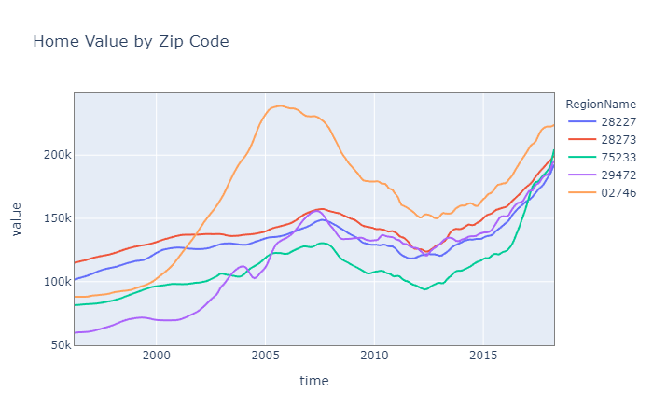
Examine Data I
General Trend
2008 housing bubble caused the 2008 -2010 decline in home value 02746 posted the biggest decline

Slide 7
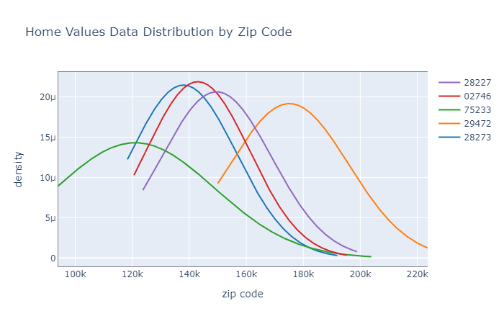
Examine Data II
Data Distribution
Home values are normally distributed Normality in data is crucial to the model

Slide 8
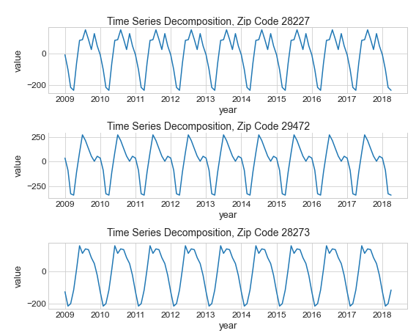
Examine Data III
Seasonality
Samples of zip codes seasonality Data don’t have significant cyclical patterns

Slide 9
ARIMA Time Series Model
Optimization | Selection
Define a range for the ARIMA model parameters Calculate all possible combinations Fit models with combinations | Select a model with the lowest Akaike’s Information Criterion

Slide 10
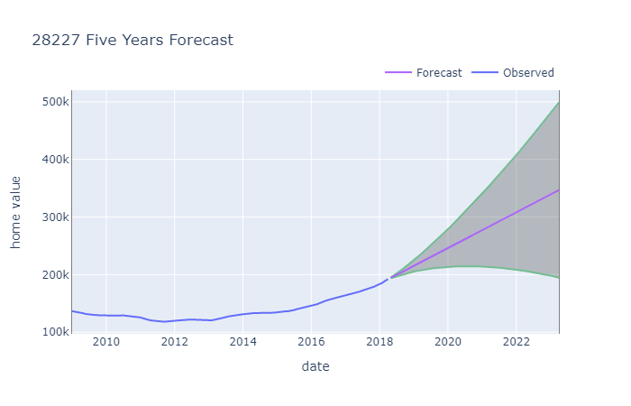
Model Forecast home value
Mint Hill, NC
Forecast values on 2023-04 Avg: 347K Max: 499K Min: 195K Purchase price on 2018-04 192K

Slide 11
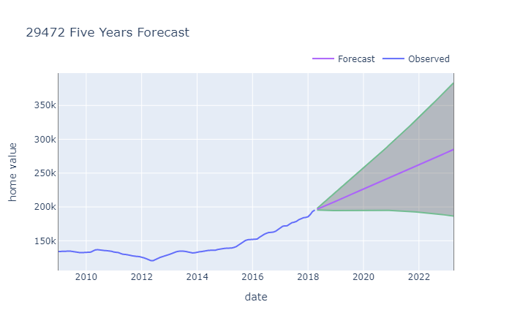
Model Forecast home value
Ridgeville, SC
Forecast values at 2023-04 Avg: 285K Max: 383K Min: 186K Purchase price on 2018-04 195K

Slide 12
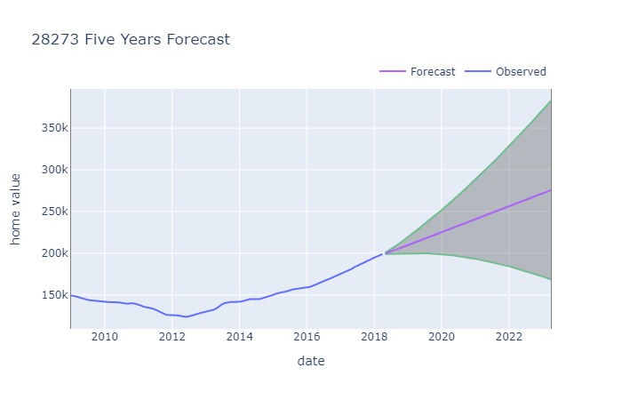
Model Forecast home value
Charlotte, NC
Forecast values at 2023-04 Avg: 276K Max: 383K Min: 167K Purchase price on 2018-04 199K

Slide 13
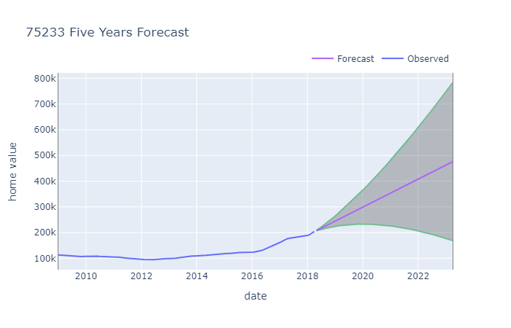
Model Forecast home value
Dallas, TX
Forecast values at 2023-04 Avg: 476K Max: 783K Min: 169K Purchase price on 2018-04 204K

Slide 14
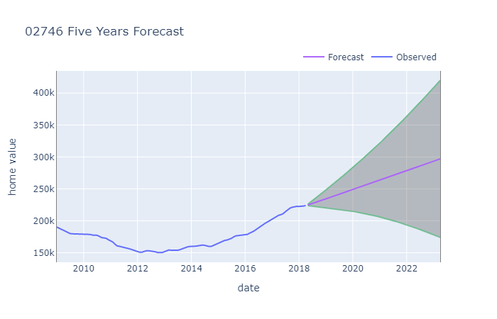
Model Forecast home value
New Bedford, MA
Forecast values at 2023-04 Avg: 297K Max: 419K Min: 174K Purchase price on 2018-04 224K

Slide 15
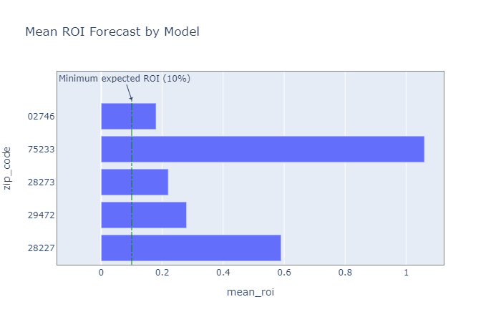
Model Forecast ROI
ROI by Zip Codes
All five zip codes exceed the minimum ROI requirement

Slide 16
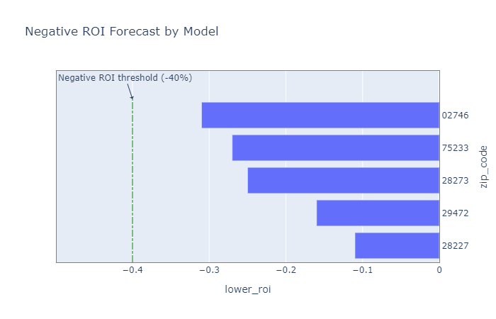
Model Forecast Lowest ROI
Lowest ROI by Zip Codes
All five zip codes are within the minimum ROI requirement

Slide 17
Conclusion
Investment Strategies Recap | Recommendations
ROI > 10% PTR > 11 < 25 COC > 8% RISD between 30th and 60th quantile Forecast ROI > 10% Forecast Lowest ROI < -40% | Following zip codes have the highest forecast ROI and lowest ROI 75233, Dallas, TX 28227, Mint Hill, NC 29472, Ridgeville, SC 28273, Charlotte, NC 02746, New Bedford, MA

Slide 18
Future work
Without Data Filter | Parameterize Investment criteria | Different Forecast Method
Fit the model without subset the data based on requirements | Parameterize investment requirements to generate data set on-the-fly | Deploy Facebook Prophet time series forecasting

Slide 19





Change things At Flatiron School you learn how the future is being built, so you can change anything, starting with a new career in code, data science, or cybersecurity.
Thank You
Collin Loo collinloo@yahoo.com Flatiron School

Slide 20
Appendix
ROI | Price-to-Rent | Cash-on-Cash
(sp – (cc(pp) + gr + pp) / (cc(pp) + gr + pp) sp=sale price after 5 yrs cc=closing cost percentage, 0.035 pp=purchase price gr=general repair, 20k | sp / 12(zori) sp=sale price after 5 yrs zori=zillow rental index | 12(zori) – (mp+ins+va) / (dp + cc) zori=zillow rental index mp=mortgage payment, loan x ((Int rate/12) x (1+Int rate/12))sq(Mort. Term) / (1+Int rate/12))sq(Mort.Term)-1) loan=80% of purchase price int rate = 2.5% mort. term = 360 ins=(purchase price/100K)(40) va=vacancy allowance, zori(10%) dp=down payment, 20%(purchase price)
 | Rental Standard Deviation
 | numpy.std(zori) zori=zillow rental index

